Slide 1



Daily Review
CFU 1
What is kinetic energy?
CFU 2
Which has more kinetic energy – a person running, or a person walking? Explain your choice.
Kinetic Energy
Kinetic energy is the energy of movement.
The faster an object moves, the more kinetic energy it has.
CFU 3
What are the 4 forms of kinetic energy?
Forms of Kinetic Energy
1. Heat Energy 2. Light Energy 3. Sound Energy 4. Electrical Energy

Slide 2


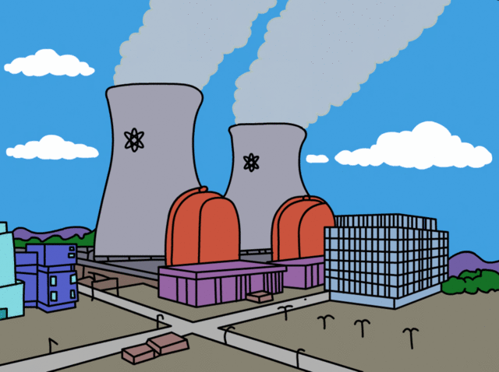
Daily Review
CFU 1
What is potential energy?
Potential Energy
Potential energy is stored in objects; it is held until it is used.
Because of this stored energy, these objects have the potential to make things happen.
CFU 2
Think, Pair, Share: Name two examples of potential energy.
CFU 3
What are the 4 forms of potential energy?
Forms of Potential Energy
1. Elastic Energy 2. Gravitational Energy 3. Chemical Energy 4. Nuclear Energy

Slide 3
Daily Review
What is the difference between kinetic and potential energy?
Identify the forms of kinetic energy in the pictures below.
a) b)
Identify the forms of potential energy in the pictures below.
a) b)

Slide 4
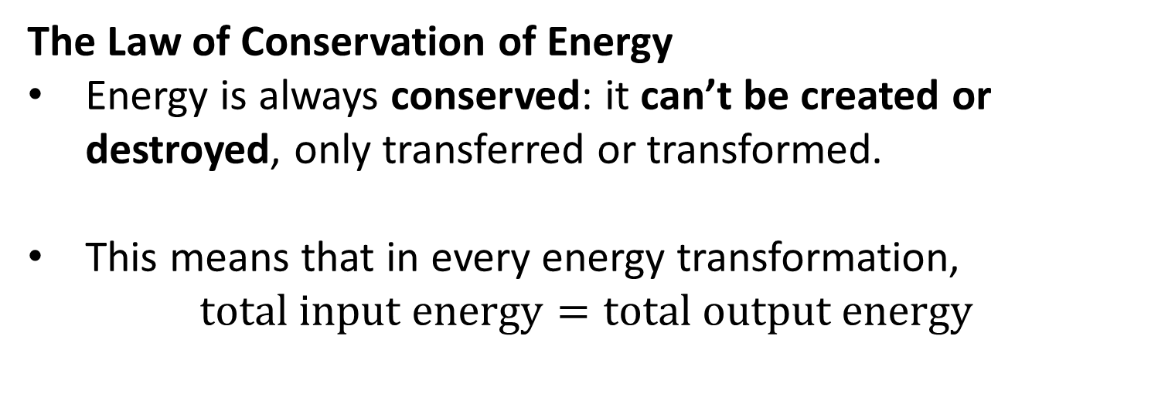
Daily Review
CFU 1
What does it mean for energy to be conserved?
The Law of Conservation of Energy
Energy is always conserved: it can’t be created or destroyed, only transferred or transformed.
This means that in every energy transformation,
$$\text{total} \text{input} \text{energy}=\text{total} \text{output} \text{energy}$$
CFU 2
How would you express this in an equation?
CFU 3
What is the unit for energy?
Vocabulary
Joule (noun) the unit used to measure energy; J for short

Slide 5
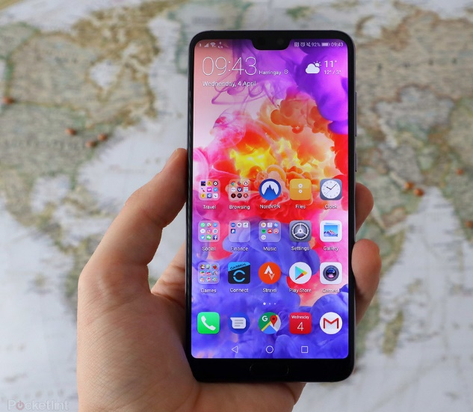
Daily Review
Let’s say that your phone battery can hold 2500 Joules (J) of chemical energy.
What are the energy forms your phone releases?
Which of these forms are wasted energy?
If you could measure the amount of energy the phone produced from that charge. How many Joules would it add up to?.

